Slide 1
Philosophy of Science
Francesco Di Iorio
francedi.iorio@gmail.com
185 5166 1135

Slide 2
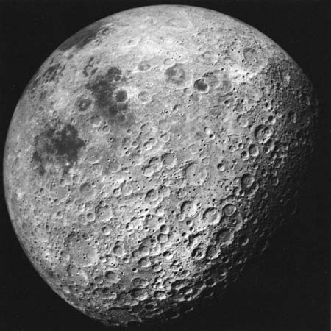
Scientists have to rule out had hoc modifications in their theories
Ad hoc modifications are not testable hypothesis added to a theory to save it from falsification
E.g. Galileo and the lunar craters

Slide 3
POPPER: there is a difference between “logical falsification” and “methodological falsification”
This means that a fact which is contrary to a theory does not allow us to reject the theory immediately
This is because when we test a theory by searching for a counter-example, we rely on the acceptance of “a considerable amount of common background knowledge”
Consequently, sometimes the falsification can depend not on the falsity of the statement we test, but on the fact that a part of the background knowledge we use is false
While falsification is always certain from a logical point of view, it is not absolutely certain from a methodological one

Slide 4
Duhem/Quine thesis
A theory cannot be conclusively falsified, because the possibility cannot be ruled out that some part of the complex test situation (protocols, auxiliary assumptions), other than the theory under test, is responsible for an erroneous prediction
Pierre Duhem (1861-1916)
William V.O. Quine (1908-2000)

Slide 5
Karl Popper: “In point of fact, no conclusive disproof of a theory can ever be produced”
This for various reasons, including the Duhem problem

Slide 6
“I believe that science is essentially critical... But I have always stressed the need for some dogmatism: the dogmatic scientist has an important role to play. If we give into criticism too easily, we shall never find out where the real power of our theories lies” (Popper, K. R. 1970. ‘Normal Science and its Dangers’, in Lakatos & Musgrave 1970, pp. 55).
According to Chalmers, Popper’s defense of dogmatism is inconsistent with his fallibilism. However, Chalmers’ view can be criticized because by “dogmatism” Popper does not seem to mean that there is a kind of knowledge that is absolutely true and unfalsifiable. Rather, Popper stresses that we need some dogmatism because all knowledge is fallible, including falsifications. Popper supports ultimately anti-dogmatism. The statement above is consistent with his fallibilsim

Slide 7
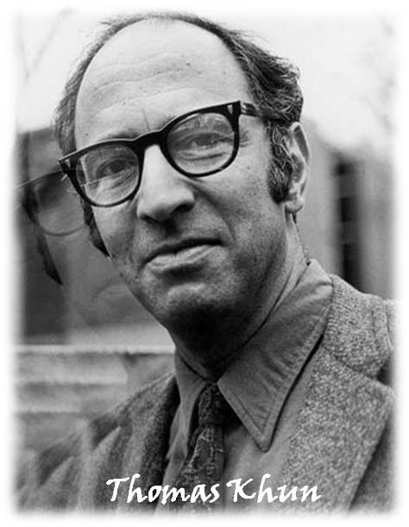
Thomas Khun (1922-1996)

Slide 8
A key feature of Kuhn’s theory is the emphasis placed on the revolutionary character of scientific progress
The history of science is characterized by revolutions
A revolution involves the abandonment of one theoretical structure (conceptual framework) and its replacement by another, incompatible one
Another important feature of science is its sociological dimension
An important role is played by the sociological characteristics of scientific communities

Slide 9
Kuhn's picture of the way a science progresses can be summarised by the following scheme:
Pre-science
Normal science (a single paradigm becomes dominant)
Crisis
Revolution
New normal science
New crisis
Paradigms: Newtonian mechanics, wave optics, analytical chemistry…

Slide 10
The existence of a (dominant) paradigm capable of supporting a normal science tradition is the characteristic that distinguishes science from non-science, according to Kuhn
Sociology lacks a paradigm and consequently cannot be regarded as science
Kuhn portrays normal science as a puzzle-solving activity governed by the rules of a paradigm

Slide 11
Normal scientists must presuppose that a paradigm provides the means for the solution of the puzzles posed within it
A failure to solve a puzzle is seen as a failure of the scientist rather than as an inadequacy of the paradigm
Puzzles that resist solution are seen as anomalies rather than as falsifications of a paradigm
Kuhn recognizes that all paradigms will contain some anomalies (for example the Copernican theory and the apparent size of Venus) and rejects all brands of falsificationism

Slide 12
According to Kuhn, an analysis of the characteristics of a crisis period in science demands the competence of the psychologist as much as that of the historian
When anomalies come to be seen as posing serious problems for a paradigm, a period of "pronounced professional insecurity" sets in
When the proponents lose their confidence in the paradigm, the time is ripe for revolution
The seriousness of a crisis deepens when a rival paradigm makes its appearance
Kuhn: "the new paradigm, or a sufficient hint to permit later articulation, emerges all at once, sometimes in the middle of the night, in the mind of a man deeply immersed in crisis".
The new paradigm will be very different from and incompatible with the old one.

Slide 13
The new paradigm will be very different from and incompatible with the old one
Each paradigm will regard the world as being made up of different kinds of things (e.g. Aristotelian universe/later theories of the universe, phlogiston theory/Lavoisier chemistry)
Rival paradigms will regard different kinds of questions as legitimate or meaningful (questions about the weight of phlogiston were important for phlogiston theorists and vacuous for Lavoisier)
As well as posing different kinds of questions, paradigms will involve different and incompatible standards (uncaused motion was nonsense for Aristotle and axiomatic for Newton)
Proponents of rival paradigms are "living in different worlds"

Slide 14
The adoption on the part of individual scientists of a new incompatible paradigm is likened by Kuhn to a "religious conversion“
There will be no purely logical argument that demonstrates the superiority of one paradigm over another

